Slide 1
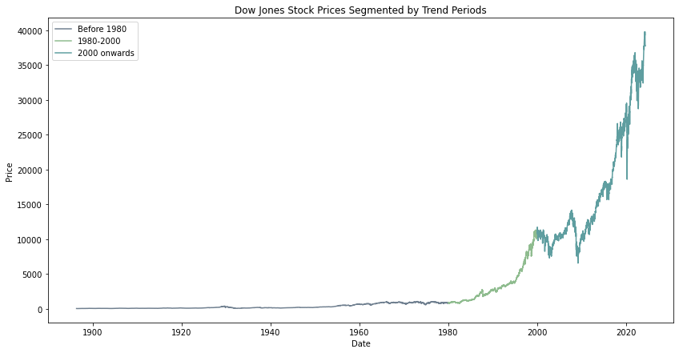


Statistical Analysis on Stock Market Index
Advanced Statistic – Timeseries Analysis
Master Student Bahare Nasir

Slide 2
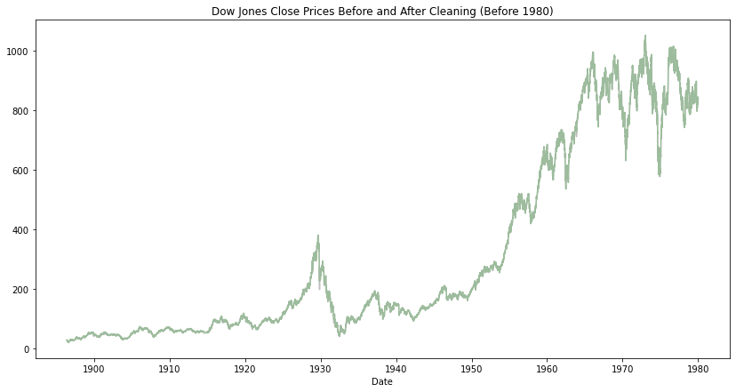
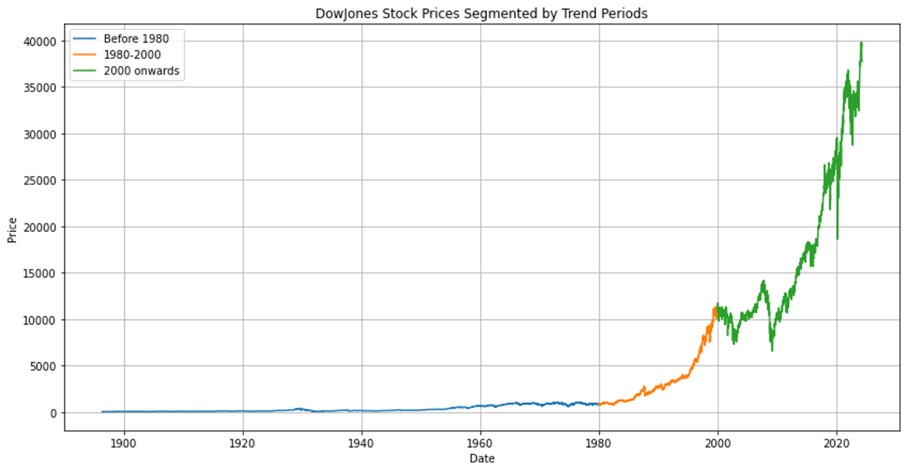
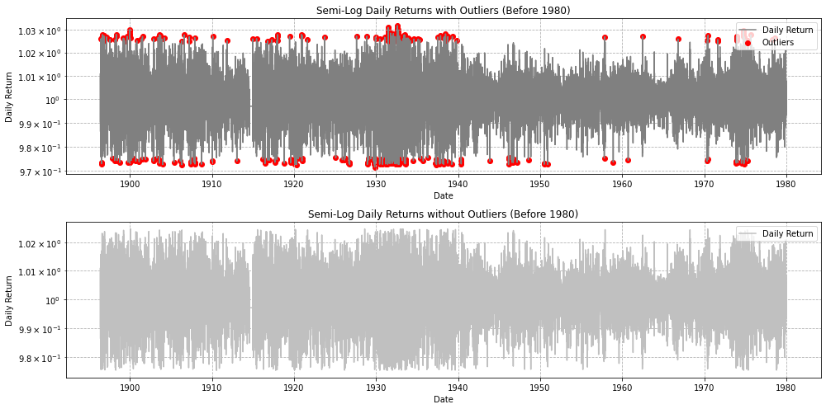
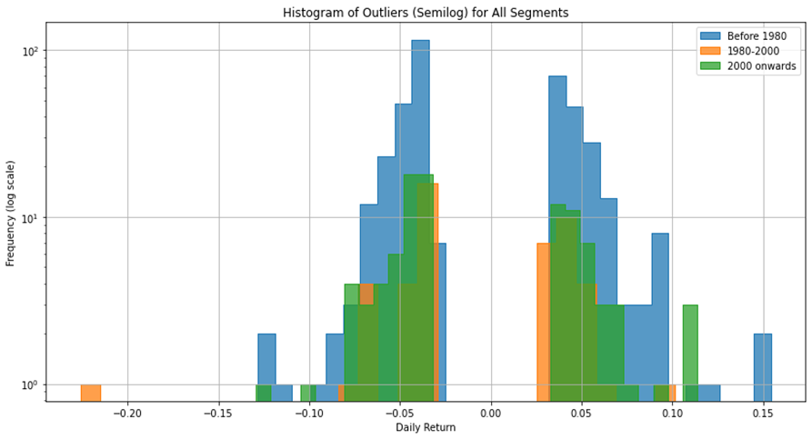
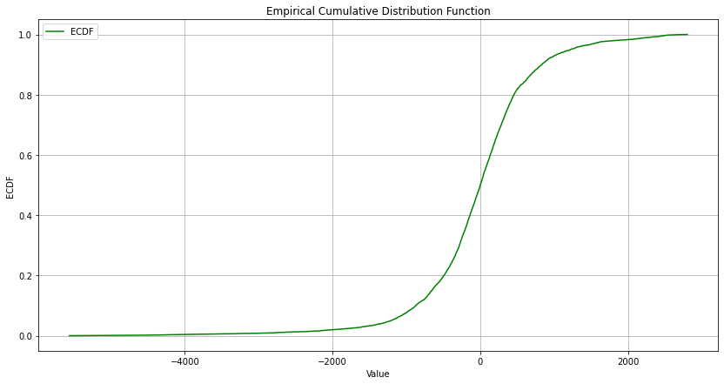
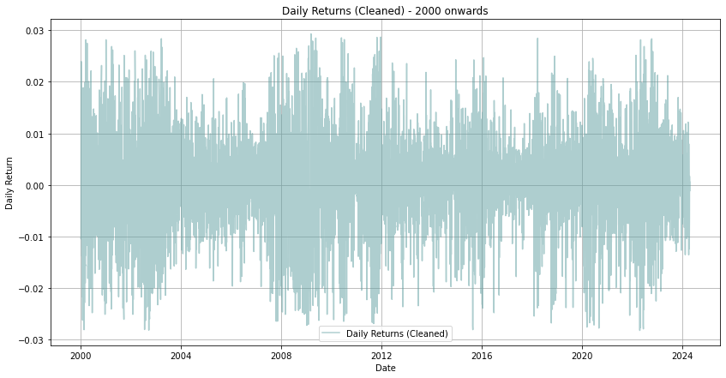
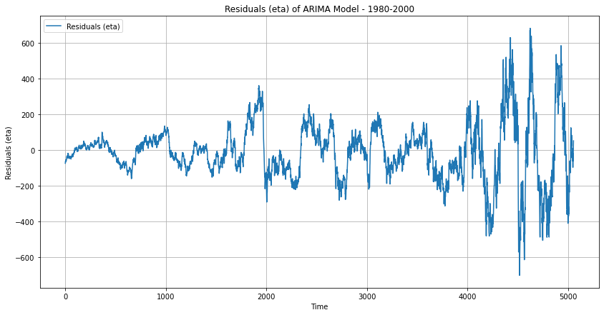
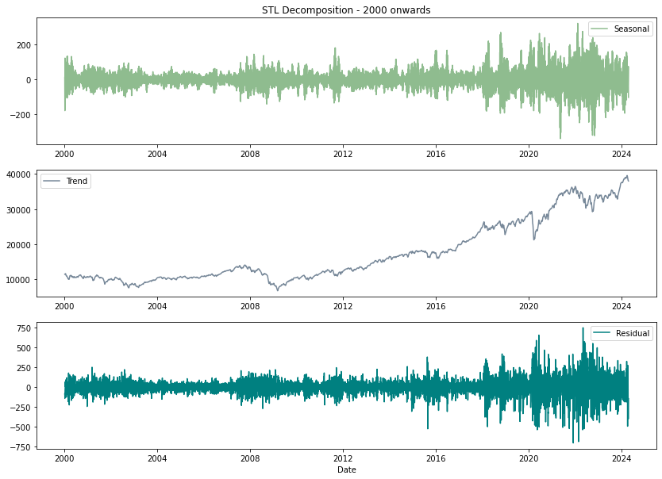
Context:
Introduction
Suggested research methodology
Data Preparation and Segmentation
Outlier Detection and Analysis
Temporal Analysis of Outliers
STL Decomposition
The Dickey-Fuller Test
Kolmogorov-Smirnov Test
Quantile Normalization of Residuals
Introducing Models
Conclusion
Future Work Suggestions – Forecasting
References

Slide 3
Introduction:
The Dynamics of the Stock Market:
Introducing the importance of the Data:
Stock Market Dynamics:
Platform for issuing, buying, and selling securities
Allows companies to raise capital, investors to earn returns
Influences:
Economic indicators
Corporate performance
Geopolitical events
Indices:
Dow Jones Industrial Average measures overall market performance
Dow Jones Industrial Average:
Closely watched stock market index
Insights from Historical Data:
Long-term economic trends
Market cycles
Impacts of major events
Benefits:
Comprehensive market behavior analysis
Enhanced understanding of stock market dynamics
Time Series Analysis

Slide 4
Understanding Time Series Analysis:
Time series analysis examines sequential data points recorded over time to extract insights, identify patterns, and make predictions.
Key Techniques:
Time Series Analysis
ARIMA:
Models trends and seasonal variations
Useful for forecasting
GARCH:
Models cyclical patterns and volatility
Helps in risk assessment
Linking Time Series Analysis and Stock Market Dynamics:
Time series analysis is essential in stock market research for uncovering patterns and forecasting future movements.
By applying techniques such as ARIMA to stock market indices like the Dow Jones, analysts can:
Models trends and seasonal effects
Captures market volatility
Benefits:
Informed investment decisions
Enhanced understanding of market dynamics

Slide 5
Suggested research methodology:
Data Collection and Preparation
Segmentation
Outlier Detection and Analysis
Temporal Analysis
Statistical Analysis
Residual Analysis
ARIMA Modeling
Conclusion

Slide 6

Data Preparation and Segmentation:
Analyze different market behaviors and trends over time:

Slide 7

Outlier Detection and Analysis:
Before 1980 Segment:
Number of outliers: 390
1980-2000 Segment
Number of outliers: 49
2000 onwards Segment
Number of outliers: 96
Total days: 21949
Percentage of outliers: 1.78%
Total days: 5055
Percentage of outliers: 0.97%
Total days: 6111
Percentage of outliers: 1.57%
Outlier Detection using Z-Score:

Slide 8
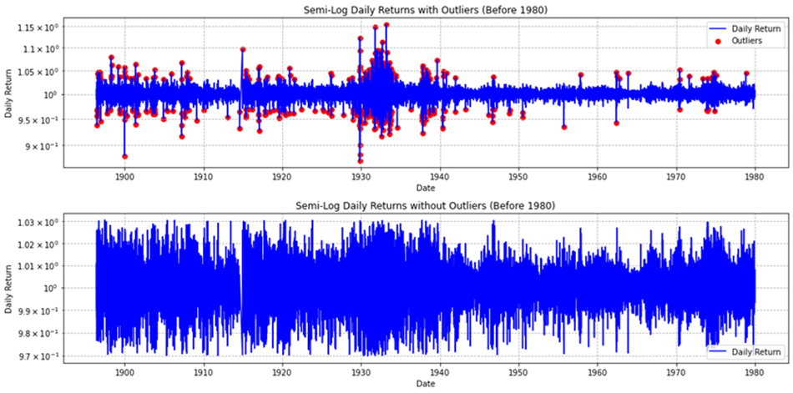
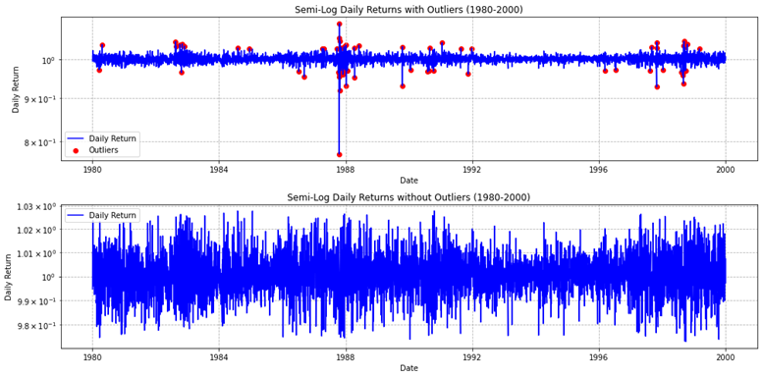
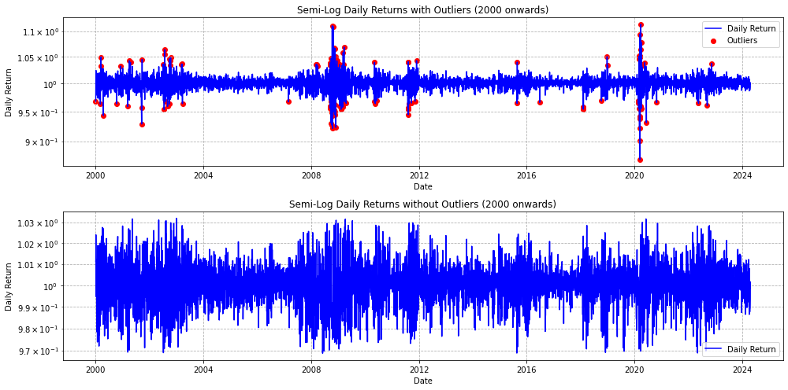

Slide 9
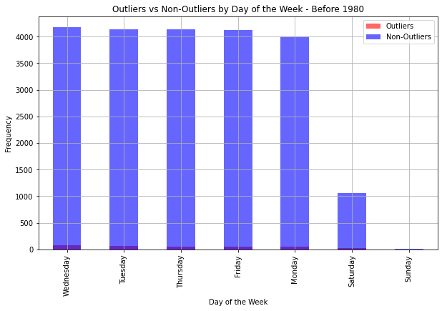
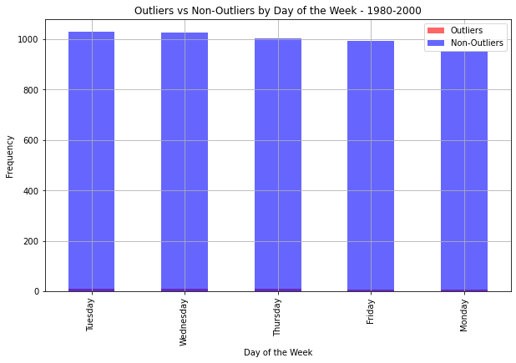
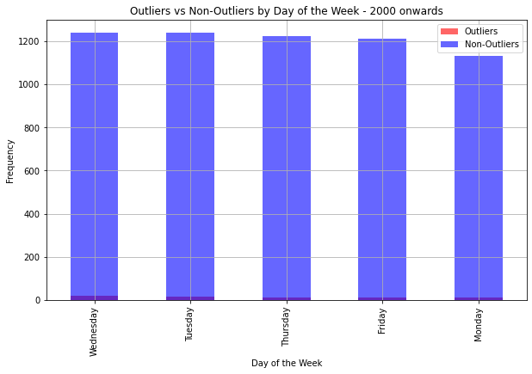
Temporal Analysis of Outliers:
Before 1980 Segment:
1980-2000 Segment
Consistent distribution across weekdays. Minimal outlier presence on weekends.
2000 onwards Segment
Similar weekday distribution. Non-outliers dominate Saturdays.
Slightly fewer data points on Saturdays.
Outliers and non-outliers show a similar distribution across weekdays.
Examining the Outliers by Day:

Slide 10

Statistical Summary:
With Outliers:
Mean: 0.0002006120043892403
Median: 0.00045372050816694376
Std Dev: 0.009786779944221355
Skewness: -0.08680493685088284
Kurtosis: 2.3858778313292817
Without Outliers:
Mean: 0.00024207818346210657
Median: 0.00046965780105079347
Std Dev: 0.008929338671849692
Skewness: -0.13288713003128094
Kurtosis: 0.8885712442784954
Conclusion:
The removal of outliers slightly increases the mean and median while reducing the standard deviation, skewness, and kurtosis, indicating a more stable and less extreme distribution of returns.

Slide 11
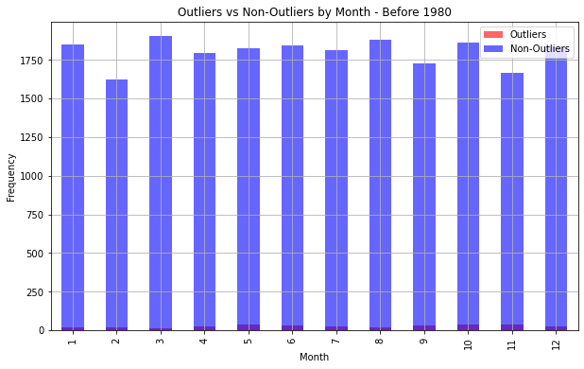
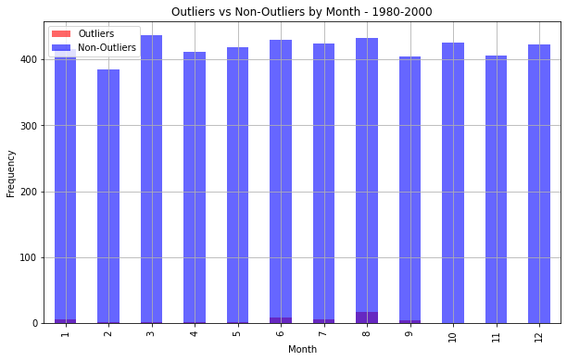
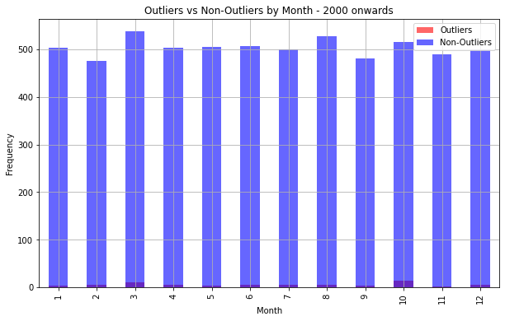
Temporal Analysis of Outliers:
Before 1980 Segment:
1980-2000 Segment
Similar to the previous period, with an even distribution. Outliers are rare, with slight peaks in some months.
2000 onwards Segment
Consistent monthly distribution. Outliers occur sporadically throughout the year.
Even distribution of non-outliers through out the year.
Outliers are sparse but appear consistently across all months.
Examining the Outliers by Month:

Slide 12

Statistical Summary:
With Outliers:
Mean: 0.000561613480491588
Median: 0.0005327934359848907
Std Dev: 0.008970794891200454
Skewness: -0.001583472030223251
Kurtosis: 1.0320307054299596
Without Outliers:
Mean: 0.0005737643109942507
Median: 0.0005402339212878804
Std Dev: 0.008539430530476962
Skewness: 0.008509281734478317
Kurtosis: 0.5013315341084388
Conclusion:
Removing outliers results in higher mean and median, and reduces the standard deviation, skewness, and kurtosis, suggesting a more normal distribution of returns.

Slide 13
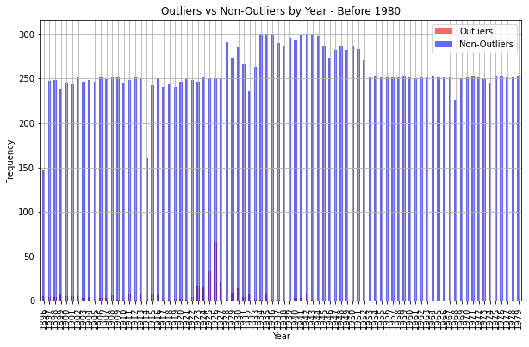
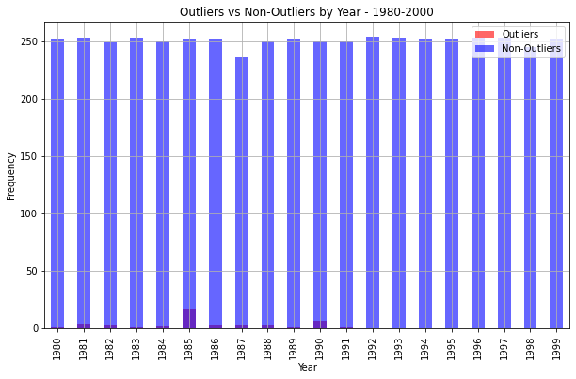
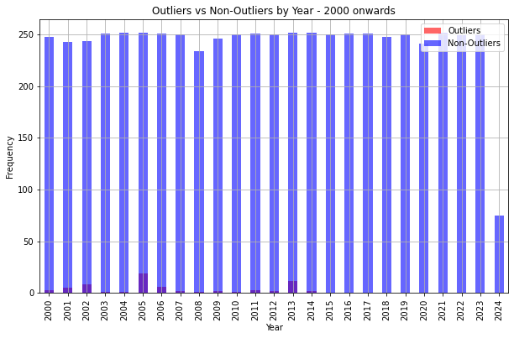
Temporal Analysis of Outliers:
Before 1980 Segment:
1980-2000 Segment
Uniform non-outlier distribution with minor dips. Noticeable outlier peaks during market crashes (e.g., Black Monday 1987).
2000 onwards Segment
Steady increase in non-outlier frequency over the years. Significant outlier spikes during major market events (e.g., Great Depression).
Continuous increase in non-outliers. Outliers more frequent during financial crises (e.g., 2008 crisis, COVID-19 pandemic).
Examining the Outliers by Year:

Slide 14
Statistical Summary:
With Outliers:
Mean: 0.000247895081587936
Median: 0.00046857553038770483
Std Dev: 0.010119739204024062
Skewness: -0.03882570290945209
Kurtosis: 2.1476866926536102
Without Outliers:
Mean: 0.00027789536495140623
Median: 0.0004835402885767781
Std Dev: 0.0094280732318196
Skewness: -0.13231775146276406
Kurtosis: 0.8300442152569953
Conclusion:
Similar to previous segments, removing outliers increases the mean and median while reducing the standard deviation, skewness, and kurtosis. This pattern highlights that outliers significantly influence the statistical properties of the data.

Slide 15
Statistical Analysis of Cleaned Data:
Before 1980 Segment:
Mean: 306.8132
Median: 152.3
Std Dev: 308.1563
Skewness: 1.0502
Kurtosis: -0.4987
1980-2000 Segment:
Mean: 3401.8538
Median: 2626.55
Std Dev: 2664.1004
Skewness: 1.3394
Kurtosis: 0.9075
2000 onwards Segment:
Mean: 17298.6278
Median: 13176.22
Std Dev: 8602.1312
Skewness: 0.9520
Kurtosis: -0.4175
Conclusion:
Significant increase in mean and median close prices after removing outliers.
Positive skewness and slightly negative kurtosis indicate more frequent moderate positive returns.
Conclusion:
mean and median close prices with increased volatility.
High positive skewness indicates a long right tail.
Positive kurtosis reflects frequent extreme returns.
Conclusion:
Significantly higher mean and median close prices.
High volatility.
Positive skewness and slightly negative kurtosis suggest frequent moderate positive returns.

Slide 16
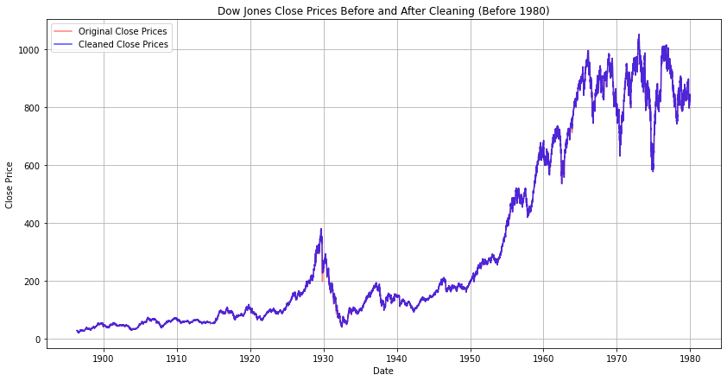
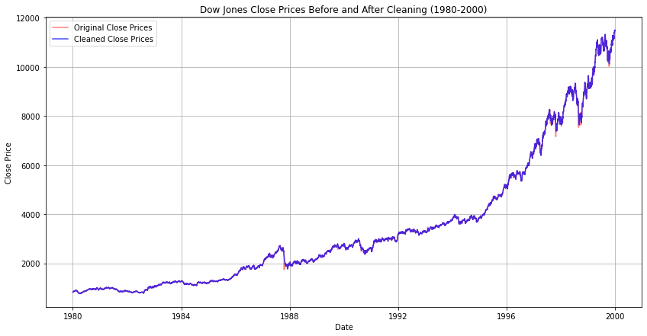
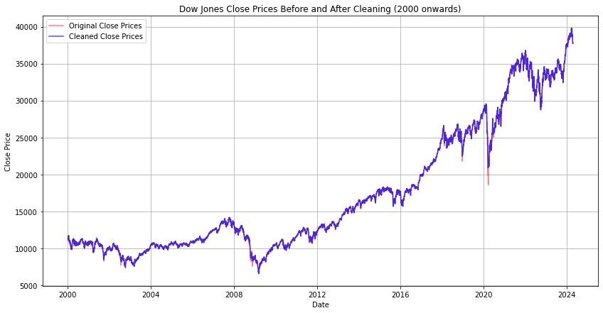

Slide 17
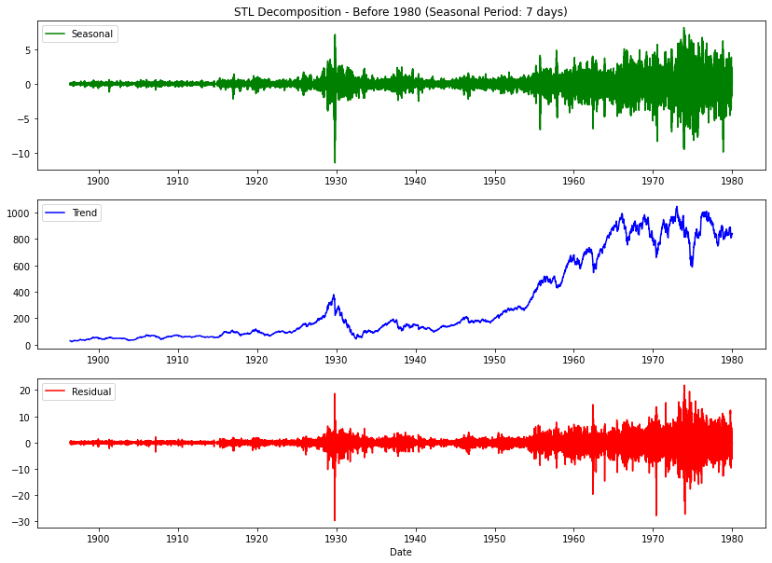
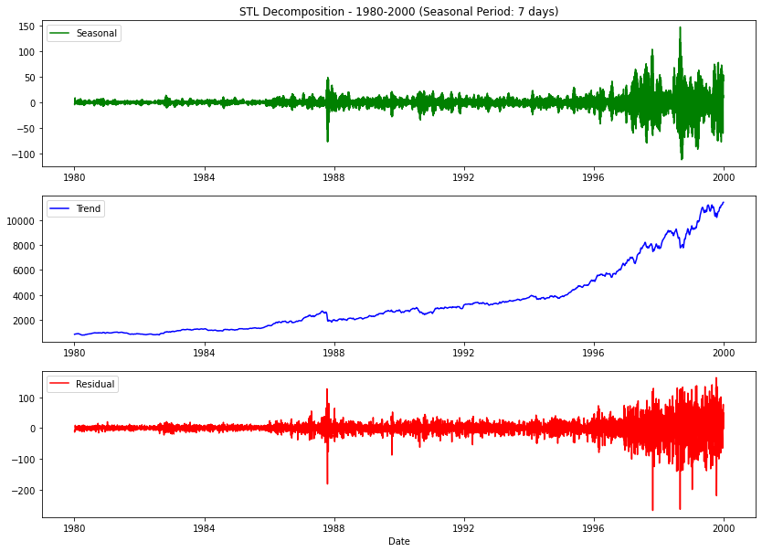
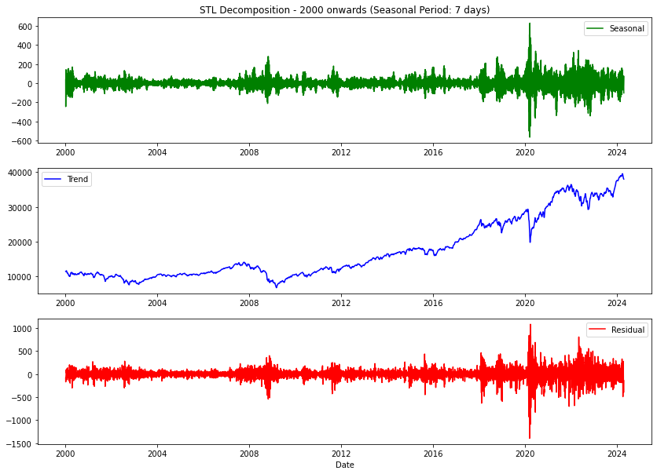
STL Decomposition:
Before 1980 Segment:
1980-2000 Segment
Consistent weekly patterns with spikes during crashes. Strong upward growth trend. Increased volatility during market corrections.
2000 onwards Segment
Regular weekly patterns, disrupted during crises. Significant upward growth. High volatility during recent crises.
Weekly patterns with increased fluctuations during economic events. Significant long-term growth with dips during crises. High volatility during downturns.
Period: 7 days

Slide 18
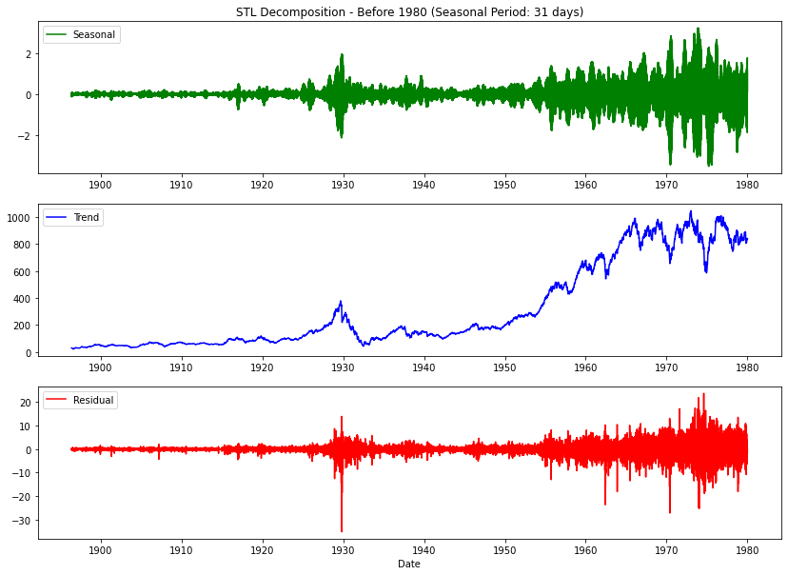
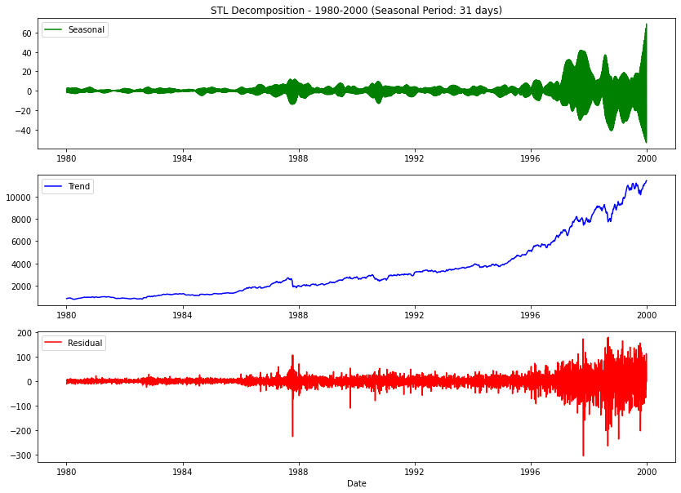
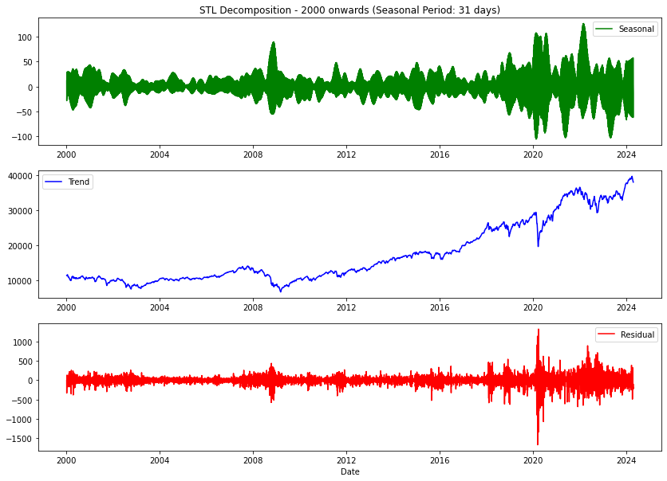
STL Decomposition:
Before 1980 Segment:
1980-2000 Segment
Consistent monthly patterns with event-related spikes. Strong growth trend. Increased volatility during corrections.
2000 onwards Segment
Regular monthly patterns disrupted during crises. Significant upward growth. High volatility during economic events.
Monthly patterns reflecting economic cycles. Steady growth with dips during crises. Higher volatility during downturns.
Period: 31 days

Slide 19
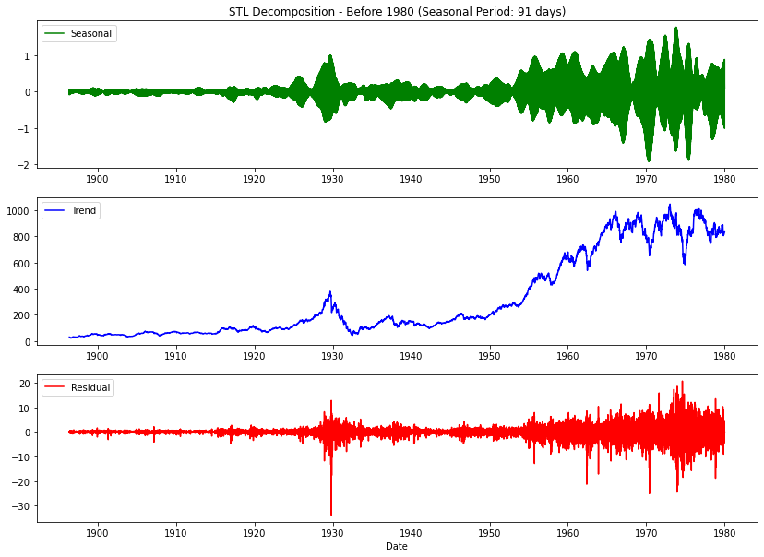
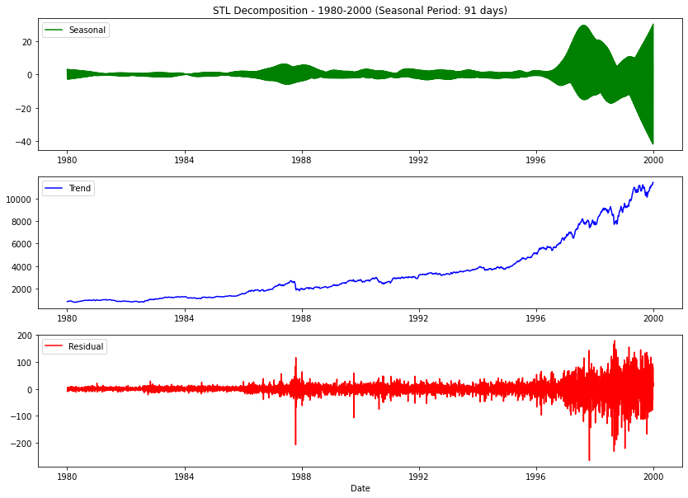
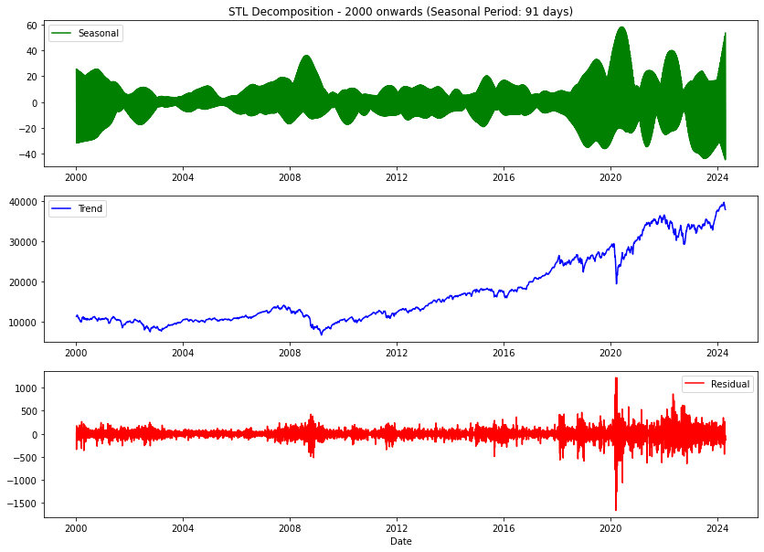
STL Decomposition:
Before 1980 Segment:
1980-2000 Segment
Consistent quarterly patterns with event-related changes. Strong upward trend. Increased volatility during corrections.
2000 onwards Segment
Regular quarterly patterns with significant disruptions during crises. Significant upward growth. High volatility during global events.
Quarterly patterns reflecting longer economic cycles. Steady growth with significant downturns. High volatility during economic downturns.
Period: 91 days

Slide 20
Introduction to Stationarity:
Start ADF Test
Estimate Parameters
Decision Rule
Collect Data
autoregressive
Compute Test Statistic
Determine Critical Values
Compare Test Statistic to Critical Values
Specify Model
regression form
τ<Critical Value (reject null hypothesis)
Else(fail to reject null hypothesis)
End
The time series is stationary.
The time series has a unit root (non-stationary).
Stationarity in time series :
statistical properties such as mean, variance, and autocorrelation structure do not change over time.
A non-stationary time series:
trends, cycles, random walks, or other structures that change over time.
The Dickey-Fuller Test:
The Dickey-Fuller test is used to determine whether a time series is stationary or not.
This test is capable of revealing the presence of unit roots in the series, indicating non-stationarity.
The Null and Alternative Hypotheses::
Null Hypothesis (H0): The time series has a unit root (i.e., it is non-stationary).
Alternative Hypothesis (HA): The time series does not have a unit root (i.e., it is stationary).

Slide 21
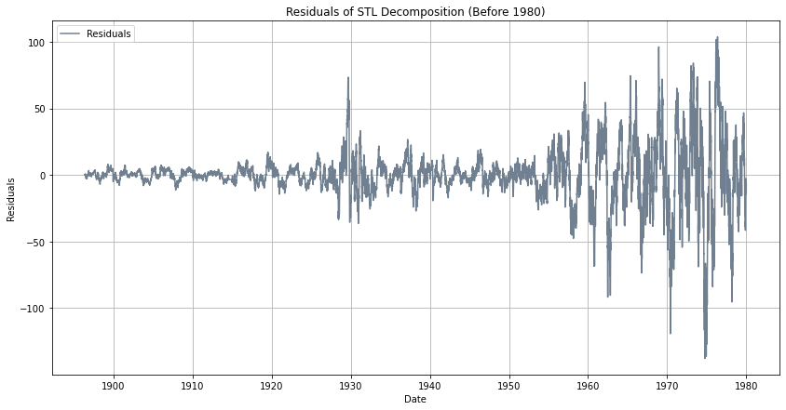
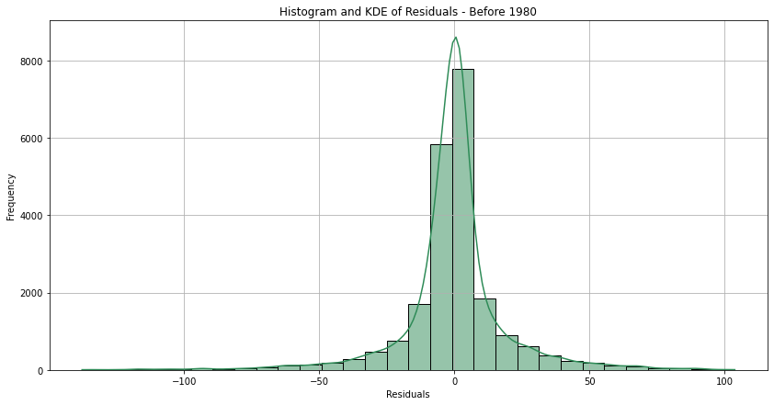

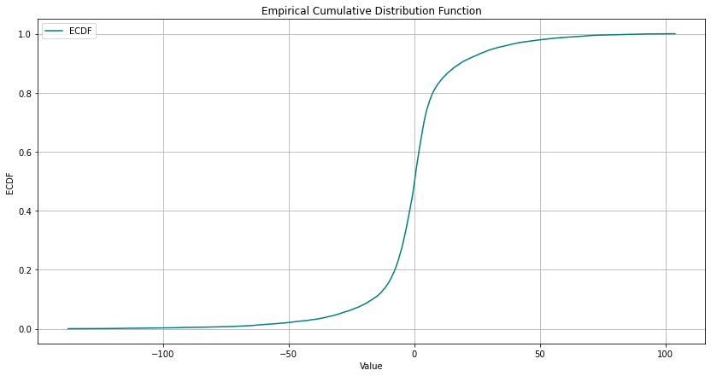
STL Decomposition - Residuals Analysis (Segment: Before 1980):
Residuals of STL Decomposition:
Observing the residuals plot, we see the variance and volatility before 1980, especially during economic events like the Great Depression.
The histogram and KDE plot show a concentration of residuals around the mean with some outliers, indicating non-normal distribution.
The ECDF plot confirms the distribution and extreme values present in the residuals.
ADF Test:
ADF Statistic: -11.6194
p-value: 2.4045e-21
Critical Values: 1%: -3.4306, 5%: -2.8617, 10%: -2.5668
Conclusion: The residuals are stationary as the p-value is less than 0.05.
Statistics for Residuals:
Mean: -0.0296
Median: 0.0835
Std Dev: 19.8883
Skewness: -0.4060
Kurtosis: 7.3487

Slide 22
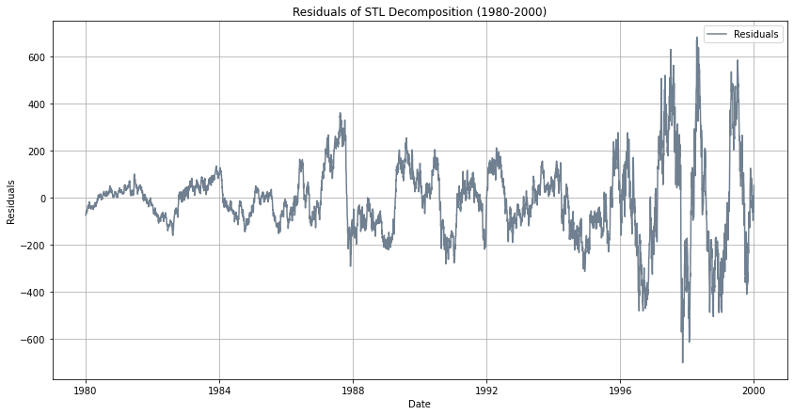
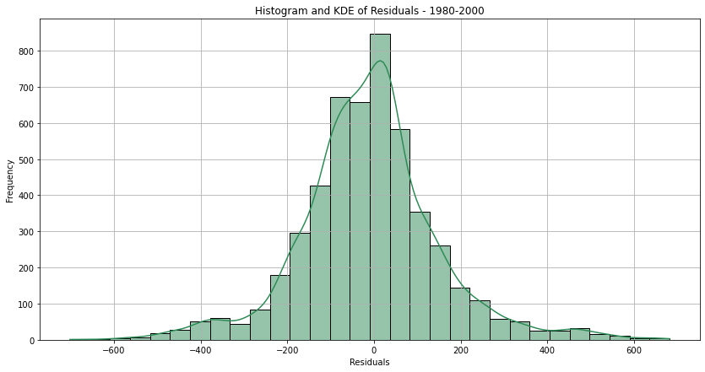
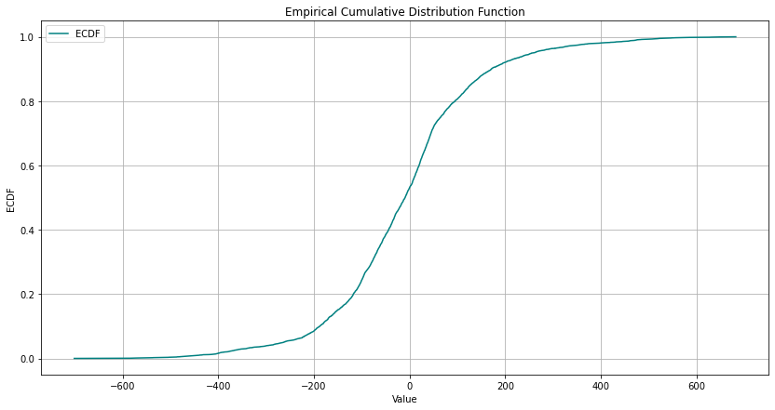
STL Decomposition - Residuals Analysis (Segment: 1980-2000):
Residuals of STL Decomposition:
The residuals plot for 1980-2000 shows increased volatility during market crashes like Black Monday in 1987.
The histogram and KDE plot display a more spread distribution with outliers, indicating periods of market corrections.
The ECDF plot confirms the distribution and extreme values present in the residuals.
ADF Test:
ADF Statistic: -5.7879
p-value: 4.9496e-07
Critical Values: 1%: -3.4317, 5%: -2.8621, 10%: -2.5671
Conclusion: The residuals are stationary as the p-value is less than 0.05.
Statistics for Residuals:
Mean: -10.3015
Median: -9.3663
Std Dev: 160.6661
Skewness: 0.2394
Kurtosis: 1.9452

Slide 23
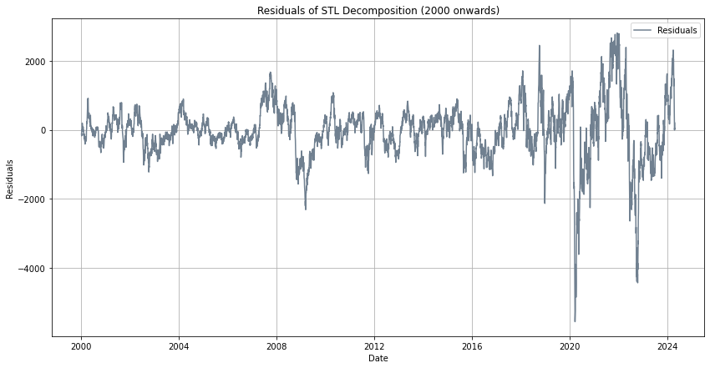
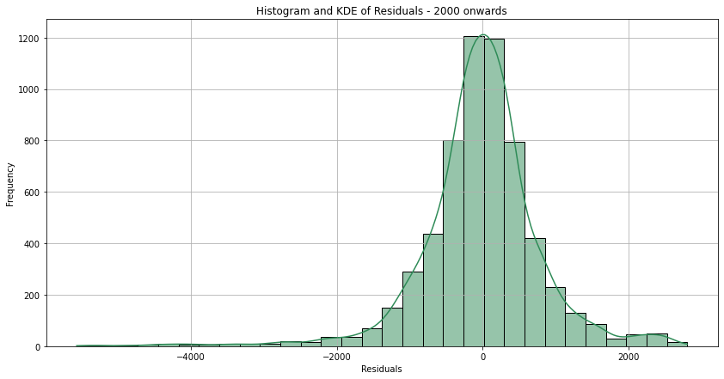
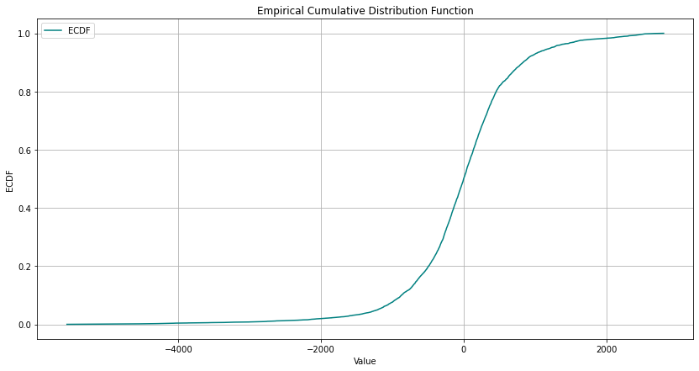
STL Decomposition - Residuals Analysis (Segment: 2000 onwards):
Residuals of STL Decomposition:
The residuals plot for 2000 onwards shows extreme volatility during events such as the 2008 financial crisis and the COVID-19 pandemic.
The histogram and KDE plot reveal a highly skewed distribution with significant outliers, indicating the market's global economic events.
The ECDF plot confirms the distribution and extreme values present in the residuals.
ADF Test:
ADF Statistic: -6.4237
p-value: 1.7661e-08
Critical Values: 1%: -3.4314, 5%: -2.8620, 10%: -2.5670
Conclusion: The residuals are stationary as the p-value is less than 0.05.
Statistics for Residuals:
Mean: -22.6995
Median: 0.9413
Std Dev: 818.1939
Skewness: -0.8748
Kurtosis: 5.8504

Slide 24

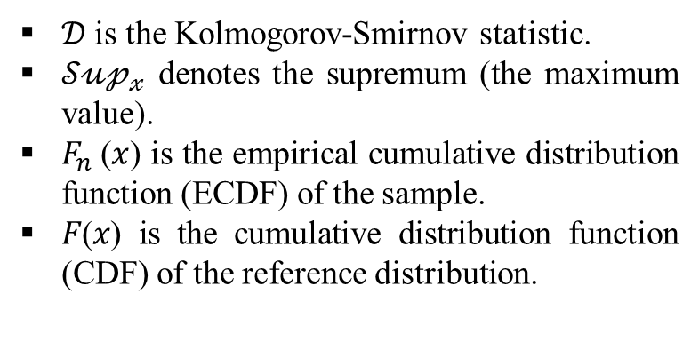
Kolmogorov-Smirnov Test:
Definition:
The KS test is a nonparametric test used to compare a sample distribution with a reference probability distribution, or to compare two sample distributions.
Purpose:
To determine if a sample comes from a population with a specific distribution, typically the normal distribution.
Null Hypothesis (H₀):
There is no difference between the observed distribution and the expected distribution.
Test Statistic:
The maximum distance (D) between the empirical cumulative distribution function (ECDF) of the sample and the cumulative distribution function (CDF) of the reference distribution.
Interpretation:
If the p-value is less than the significance level (e.g., 0.05), reject H₀, indicating that the sample does not follow the reference distribution.
$𝒟$ = ${𝒮\text{𝓊𝓅}}_{𝓍}$| $F_{n}$(𝑥) - 𝐹(𝑥)|
$𝒟$ is the Kolmogorov-Smirnov statistic.
${𝒮\text{𝓊𝓅}}_{𝓍}$ denotes the supremum (the maximum value).
$F_{n}$(𝑥) is the empirical cumulative distribution function (ECDF) of the sample.
𝐹(𝑥) is the cumulative distribution function (CDF) of the reference distribution.

Slide 25
Start KS Test
Calculate CDF
Decision Rule
Specify Reference Distribution:
Compute KS Statistic
Determine P-value
Compare P-value with Significance Level
Calculate ECDF
p-value < significance level
(Reject Null Hypothesis)
Else(Fail to Reject Null Hypothesis)
End
The sample data does not follow the reference distribution.
The sample data follows the reference distribution.
For the period "Before 1980":
Statistic: 0.1569
P-value: 0.0
Interpretation: The residuals are not normally distributed.
For the period "1980-2000":
Statistic: 0.0751
P-value: 3.00979268180537e-25
Interpretation: The residuals are not normally distributed.
For the period "2000 onwards":
Statistic: 0.0868
P-value: 1.4281487679606139e-40
Interpretation: The residuals are not normally distributed.

Slide 26
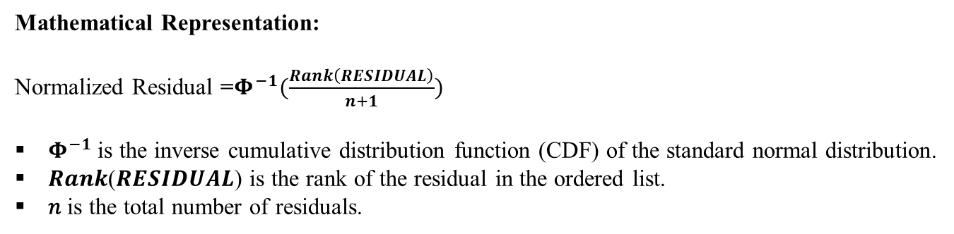
Quantile Normalization of Residuals:
Start Quantilization
Compute Quantiles of Standard Normal Distribution
Map Each Residual to Corresponding Quantile
Order Residuals from Smallest to Largest
End
STL Decomposition
Validate Normality: K-S Test, Q-Q plot, Histogram
Objective:
To transform residuals so that they follow a standard normal distribution.
Mathematical Representation:
Normalized Residual =$Φ^{−1}(\frac{Rank\left(RESIDUAL\right)}{n+1})$
$Φ^{−1}$is the inverse cumulative distribution function (CDF) of the standard normal distribution.
𝑹𝒂𝒏𝒌(𝑹𝑬𝑺𝑰𝑫𝑼𝑨𝑳) is the rank of the residual in the ordered list.
𝑛 is the total number of residuals.
Advantages:
Reduces the effect of outliers.
Ensures the residuals follow a normal distribution

Slide 27
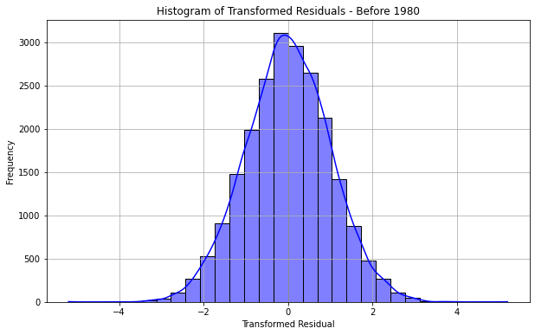


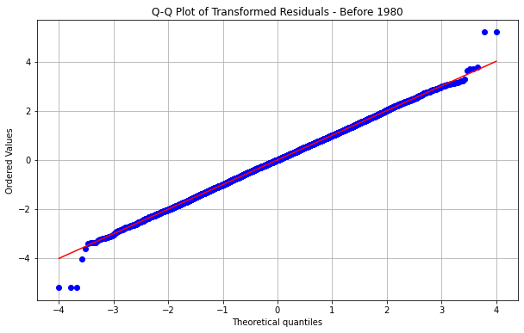
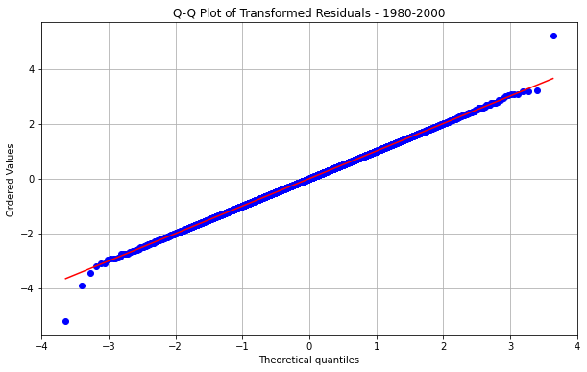
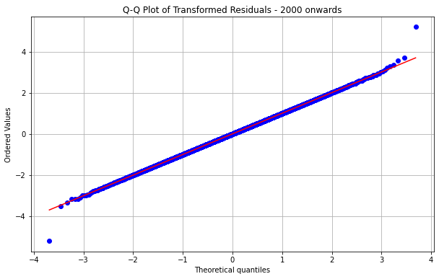
Analysis and Results of Residuals Quantile Normalization:
Kolmogorov-Smirnov Test:
Statistic: 0.00731
P-value: 0.1893201725285546
Conclusion: the transformed residuals are normally distributed.
Statistic: 0.0014520
P-value: 1.0
Conclusion: the transformed residuals are normally distributed.
Statistic: 0.001286
P-value: 0.8
Conclusion: the transformed residuals are normally distributed.

Slide 28
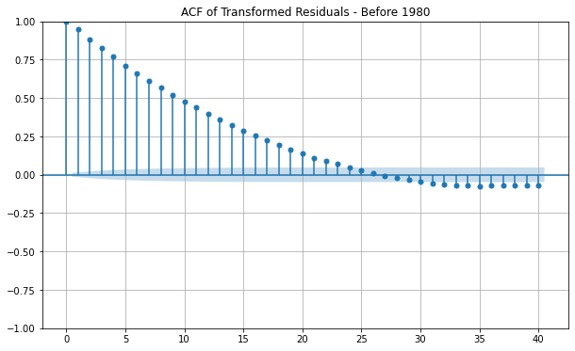
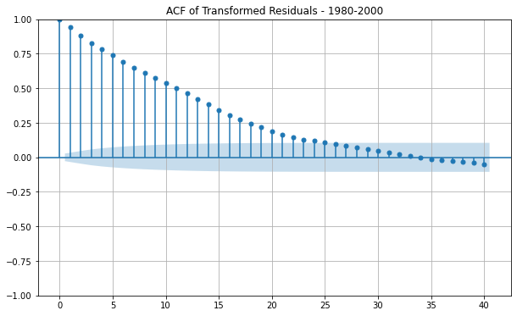




ACF and PACF of Transformed Residuals: Before 1980, 1980-2000, and 2000 Onwards:
Result:
Autocorrelation Function (ACF):
Gradual decline in correlation over lags, indicating autocorrelation across all segments.
Partial Autocorrelation Function (PACF):
Significant spike at lag 1, with minimal subsequent correlations across all segments.

Slide 29

Introducing Models:
ARMA(p, q) Model
ARMA Model Identification, Estimation, and Evaluation
Definition:
ARMA stands for AutoRegressive Moving Average model.
Combines two parts: AutoRegressive (AR) part and Moving Average (MA) part.
Formula:
$Z_{t}=φ_{1}$ $Z_{t−1}+…+φ_{p}$ $Z_{t−p}+$ $a_{t}−{\text{θ}}_{1}a_{t−1}−…−$ ${\text{θ}}_{q}$ $a_{t−q}$
$Z_{t}$is the time series value at time 𝑡.
$φ_{i}$​ are the coefficients of the AR part.
${\text{θ}}_{i}$are the coefficients of the MA part.
$a_{t}$ t​ is white noise error term.
CF and PACF:
ACF (Autocorrelation Function):
Measures the correlation between observations at different lags.
PACF (Partial Autocorrelation Function):
Measures the correlation between observations at different lags after removing the effects of intermediate lags.
Model Identification Using ACF and PACF:
AR(p): ACF tails off, PACF cuts off after p lags.
MA(q): ACF cuts off after q lags, PACF tails off.
ARMA(p, q): Both ACF and PACF tail off.
Time Series Analysis

Slide 30
Consider a general ARIMA Model
Data Preparation
Check for stationarity: the Augmented Dickey-Fuller (ADF)
If p-value < 0.05, data is stationary; otherwise, apply differencing.
Plot the time series data.
Using ACF and PACF
Identify the order (p) from PACF where it cuts off.
Identify the order (q) from ACF where it cuts off.
Model Selection
Choose tentative ARMA(p, q) model based on ACF and PACF plots
Estimate the Model
Use software to estimate ARMA model parameters
Model Evaluation
Check residuals using ACF and PACF plots
Residuals should show no significant autocorrelation
Perform diagnostic tests (e.g., Ljung-Box test) on residuals
Ensure residuals behave like white noise
Iterative Process
If model is inadequate, go back to Step 3 and adjust p and q
Re-estimate parameters and re-evaluate the model.
Final Model Validation
Confirm model adequacy
Ensure all diagnostic checks are satisfied
Start Forecasting
ARMA Model Flowchart:

Slide 31


ARIMA Model Residuals - Before 1980:
ACF of Residuals:
The lack of significant autocorrelations beyond lag 1 suggests that the residuals do not exhibit patterns of correlation over time, indicating that the model has successfully captured the underlying data structure.
PACF of Residuals:
The significant spike at lag 1 with minimal correlations at higher lags further supports that the model has accounted for the primary autocorrelation structure in the data.
Residuals (eta) Plot:
The residuals behaving like white noise, fluctuating around zero without any discernible pattern, is a strong indication that the residuals are random. This randomness implies that the model has effectively captured the information in the data, leaving only random noise as residuals.
Model Diagnostics:
Minimal autocorrelation in the residuals is a key diagnostic check for a good ARIMA model fit.The residuals centered around zero with no obvious pattern suggest that there are no systematic errors left unmodeled.

Slide 32
ARIMA Model Residuals:
Before 1980:
1980-2000:
2000 Onwards:
ACF and PACF of Residuals:
No significant autocorrelations beyond lag 1 in ACF; significant spike at lag 1 in PACF indicates effective model capture.
Residuals (eta) Plot:
Residuals behave like white noise, implying the model has captured the data's information, leaving only random noise.

Slide 33
Model Evaluation:
The ACF of residuals shows no significant autocorrelations beyond lag 1.
The PACF of residuals has a significant spike at lag 1, indicating minimal correlation at higher lags.
Residuals exhibit minimal autocorrelation, suggesting a good model fit.
Model Validation:
The Ljung-Box Q-statistics for all segments showed p-values indicating no significant autocorrelation in the residuals:
Before 1980: Q-statistic = 553.74, p-value = 0.00.
1980-2000: Q-statistic = 3.18, p-value = 0.07.
2000 Onwards: Q-statistic = 2.29, p-value = 0.13.
Overall, the residuals meet the criteria for minimal autocorrelation, validating the model's adequacy.
Model Evaluation and Validation:
1980-2000:

Slide 34
Conclusion:
Model Adequacy:
The ARIMA(1,0,0) model effectively captured the underlying data structure, with residuals showing minimal autocorrelation across all time segments.
Diagnostic Tests:
Ljung-Box Q-statistics confirmed that residuals are uncorrelated and exhibit constant variance, validating the model's adequacy.
Predictive Reliability:
Given the minimal autocorrelation in residuals and successful diagnostic tests, the ARIMA(1,0,0) model is suitable for reliable forecasting of future stock prices.

Slide 35
Scenario Analysis:
Assess impact of various economic conditions on stock prices.
Prediction Intervals:
Provide a range of possible future values to capture uncertainty.
Advanced Models:
Explore deep learning models like LSTM for non-linear dependencies.
Combine ARIMA with machine learning techniques.
Real-Time Forecasting:
Implement automated pipelines for data collection and forecasting.
Develop interactive dashboards for real-time updates.
Future Work Suggestions - Forecasting

Slide 36
References:
Box, G. E. P., Jenkins, G. M., Reinsel, G. C., & Ljung, G. M. (2015). Time Series Analysis: Forecasting and Control. John Wiley & Sons.
Hyndman, R. J., & Athanasopoulos, G. (2018). Forecasting: Principles and Practice. OTexts. Retrieved from https://otexts.com/fpp3/
Ljung, G. M., & Box, G. E. P. (1978). On a Measure of Lack of Fit in Time Series Models. Biometrika, 65(2), 297-303.
Wei, W. W. S. (2006). Time Series Analysis: Univariate and Multivariate Methods. Pearson Education.
Lv, P.; Wu, Q.; Xu, J.; Shu Y. Stock Index Prediction Based on Time Series Decomposition and Hybrid Model. Entropy 2022, 24, 146. https://doi.org/10.3390/e24020146
Journal of Statistical and Econometric Methods, vol.4, no.4, 2015, 41-53 , ISSN: 1792-6602 (print), 1792-6939 (online) , Scienpress Ltd, 2015

Slide 37
……………………….
…………………

Slide 38

…………………………
…………
………………………………..
…………….

Slide 39
……………
--------------------------

Slide 40
------------------
--------------------------------

